Slide 1
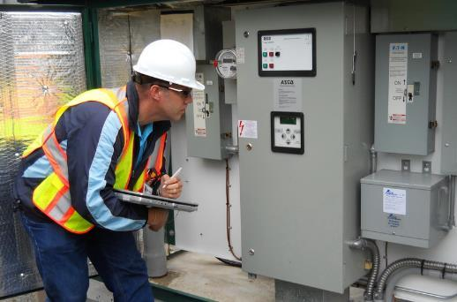
Facility Condition Assessment (FCA)
The FCA includes the following components:
Building Structure
Foundations, Superstructure and Stairwells
Building Envelope
Walls, Windows, Doors and Roof
Site Improvements
Parking Lots, Walkways, Signage, Fencing, Athletic Fields, etc.
Building Interiors
Doors and Finishes (Floors, Paint, Cabinets, Lockers, etc.)
Building MEPF Services (Mechanical, Electrical, Plumbing, and Fire Safety)
Water Systems, Mechanical Systems, Electrical Systems, Elevators, Fire Safety Systems, Communications Systems, and Security Systems
Equipment and Furnishings
Kitchen Equipment, Pool Equipment, Scoreboards, Theatre Systems, etc

Slide 2
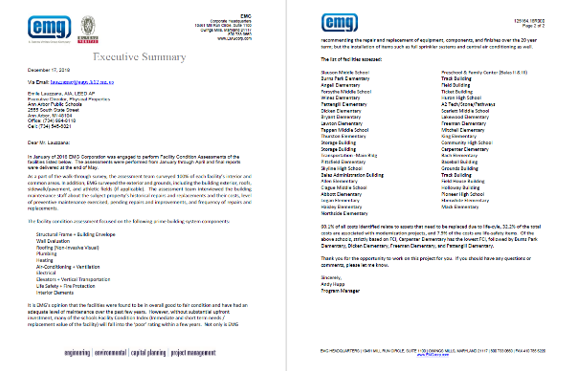
EMG Executive Summary

Slide 3
Facility Condition Assessment - Results
2-Year Investment Needs | $ 148,562,000
5-Year Investment Needs | $ 344,378,000
10-Year Investment Needs | $ 504,274,000
20-Year Investment Needs | $ 823,780,000

Slide 4
20-Year FCA Investment Needs
$ 823,779,962

Slide 5
What does the FCA Include and Not Include?
Includes | Does Not Include
Existing Infrastructure Renewals and Replacements | New Classroom Additions for Student Growth
Schools Maintained in “Good/Fair” Condition | Schools Maintained in “Good/Exceptional” Condition
Air Conditioning added all schools | Furniture Refresh
Solar Power and Geothermal to reduce Carbon Footprint where feasible | Busing Fleet Refresh
Security Enhancements | Technology Refresh
Standard Classroom Environments (code minimum) | Optimized Healthy Classroom Environments
Union Wages | Constructing New/Replacement Schools

Slide 6
Cost of Items Not Included in the FCA
Additional Investment Needs (Not in FCA) | Annual Cost
New Schools and Classrooms for Student Population Growth | $ 10M/year
Furniture Refresh | $1M/year
Busing Fleet Refresh | $2M/year
Technology Refresh | $5M/year
Maintaining Schools in “Good/Exceptional” Condition | $5M/year
Annual TOTAL Additional Investment Needs | $23M/year
20-year TOTAL Additional Investment Needs (@3% inflation) | $ 618M

Slide 7
Total Capital Needs
 | FCA Needs | Other Needs (Not In FCA) | Total Needs
2-Years | $ 148,562,000 | $ 46,690,000 | $ 195,252,000
5-Years | $ 344,378,000 | $ 122,110,124 | $ 466,488,124
10-Years | $ 504,274,000 | $ 263,669,224 | $ 767,943,224
20-Years | $ 823,780,000 | $ 618,018,613 | $ 1,441,798,613

Slide 8
Capital Needs vs. Available Funds
 | Total Needs | Available Funds | Gap
2-Years | $ 195,252,000 | $ 45,157,553 | $ 150,094,447
5-Years | $ 466,488,124 | $ 117,320,542 | $ 349,167,582
10-Years | $ 767,943,224 | $ 222,241,923 | $ 545,701,301
20-Years | $ 1,441,798,613 | $ 581,915,075 | $859,883,538

Slide 9
$1,441,798,613 – Total Capital Needs
$859,883,538 – Funding Gap
$581,915,075 - Available Funds

Slide 10
Options – Funding vs. Time vs. Quality
Funding
Quality
Time
Increased bond amounts create rapid school modernization + higher quality

Slide 11
Options – Quality of Classroom Environments
LESS BOND EXPENDITURE MORE BOND EXPENTITURE
REDUCED
Air Quality
INCREASED
REDUCED
Thermal Comfort
INCREASED
REDUCED
Daylight and Views
INCREASED
REDUCED
Acoustical Quality
INCREASED
Increased bond amounts create higher quality classroom environments

Slide 12
Options – Student Performance
LESS BOND EXPENDITURE MORE BOND EXPENTITURE
REDUCED
Cognitive Function
INCREASED
REDUCED
Attention and Focus
INCREASED
REDUCED
Visual Acuity
BETTER
REDUCED
School Pride
INCREASED
Increased bond amounts create healthier and higher performing students

Slide 13
Options – Quality of School Spaces
LESS BOND EXPENDITURE MORE BOND EXPENTITURE
LESS
Teacher Classroom Control / Flexibility
MORE
LESS
Modern Technology
MORE
LESS
Support Spaces
MORE
LESS
Special Classrooms
MORE
Increased bond amounts create higher quality support spaces and technology

Slide 14
Options – General Fund Impact
LESS BOND EXPENDITURE MORE BOND EXPENTITURE
MORE COST
Utility Costs
LESS COST
MORE COST
Repair and Maintenance
LESS COST
MORE COST
Cleaning Costs
LESS COST
MORE COST
Emergency
Restoration
LESS COST
Increased bond amounts create lower General Fund expenditure

Slide 15
Options – Risk and Security
LESS BOND EXPENDITURE MORE BOND EXPENTITURE
LESS SAFE
Schools Safety and Security
MORE SAFE
LESS PREPARED
Disaster Preparedness
MORE PREPARED
MORE COST
Insurance Costs
LESS COST
LESS PREPARED
Climate Change Adaptation
MORE PREPARED
Increased bond amounts create lower risk and more security

Slide 16
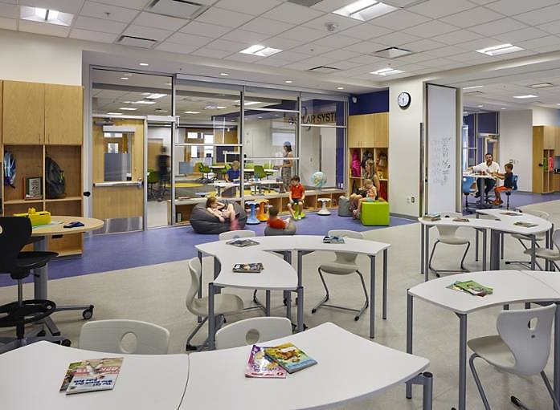
What could we create?

Slide 17
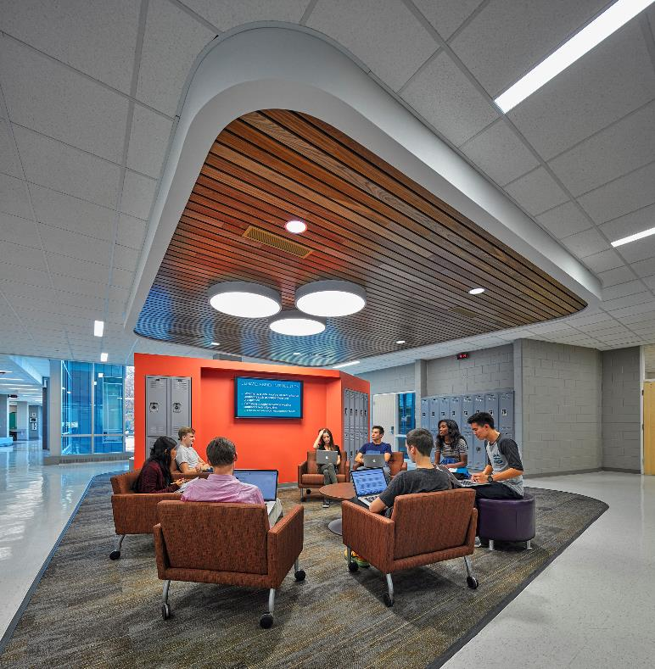
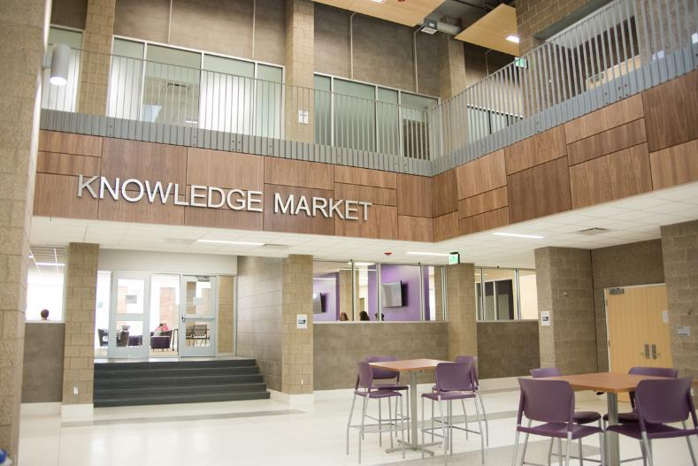
Bloomfield Hills High School
Bloomfield Hills, MI – Stantec Architects

Slide 18
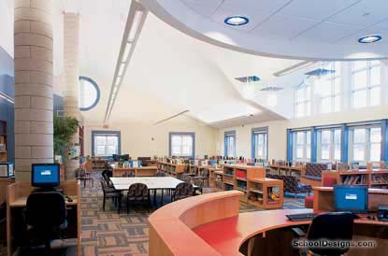
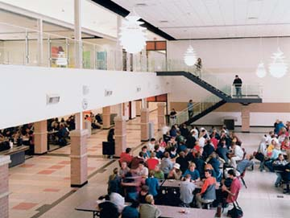
Dexter High School
Dexter, MI – Kingscott Architects

Slide 19
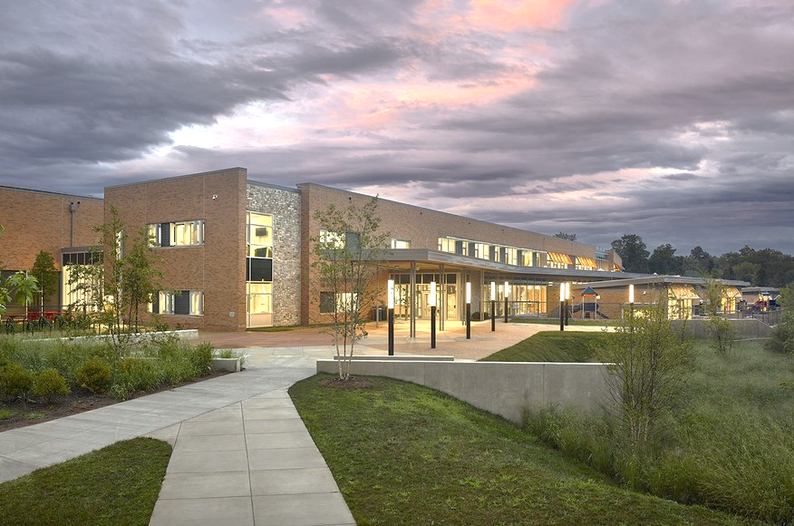
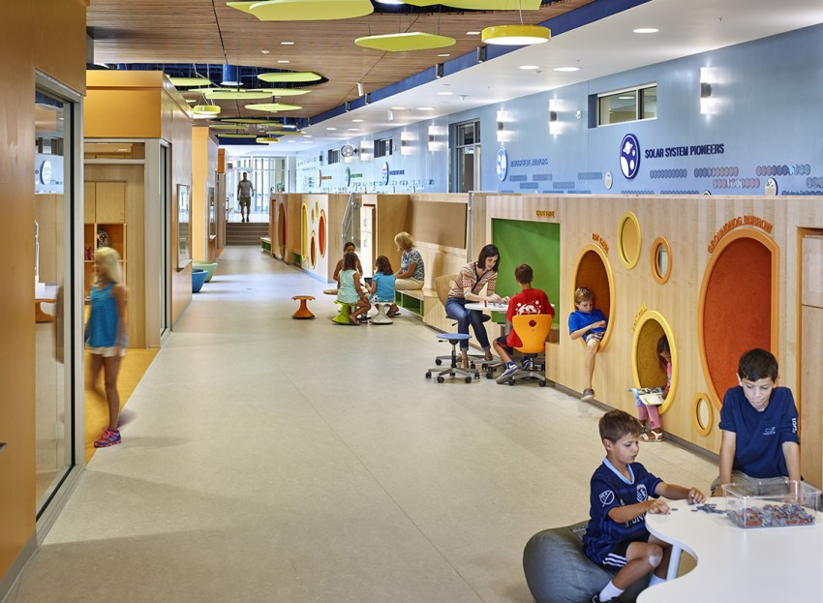
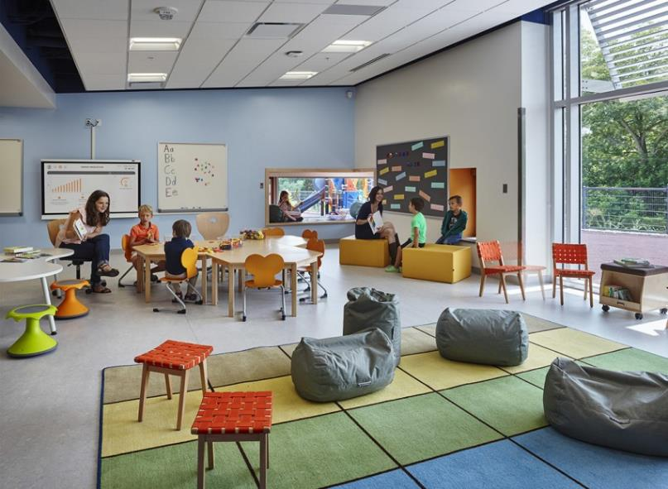
Discovery Elementary
Arlington, VA – VMDO Architects
*Net-Zero Energy*

Slide 20
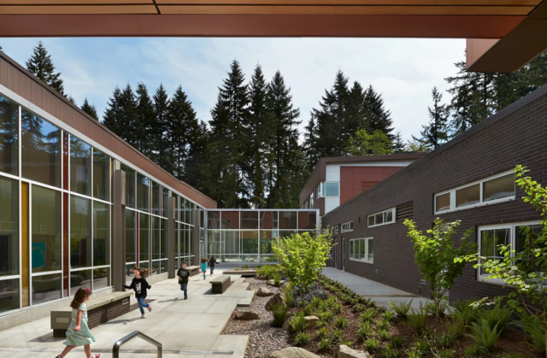
Cherry Crest Elementary
Belleview, WA – NAC Architects
*Nature Focused Design*

Slide 21
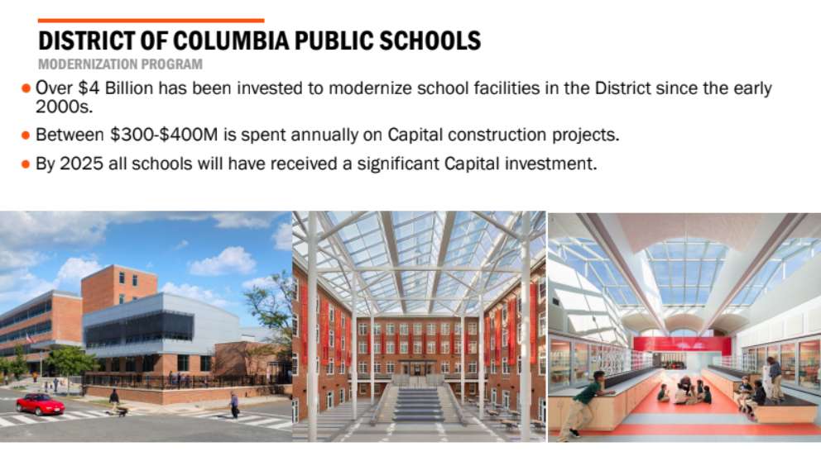

Slide 22
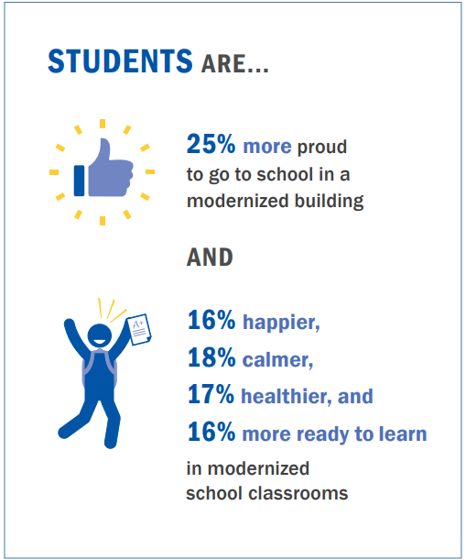
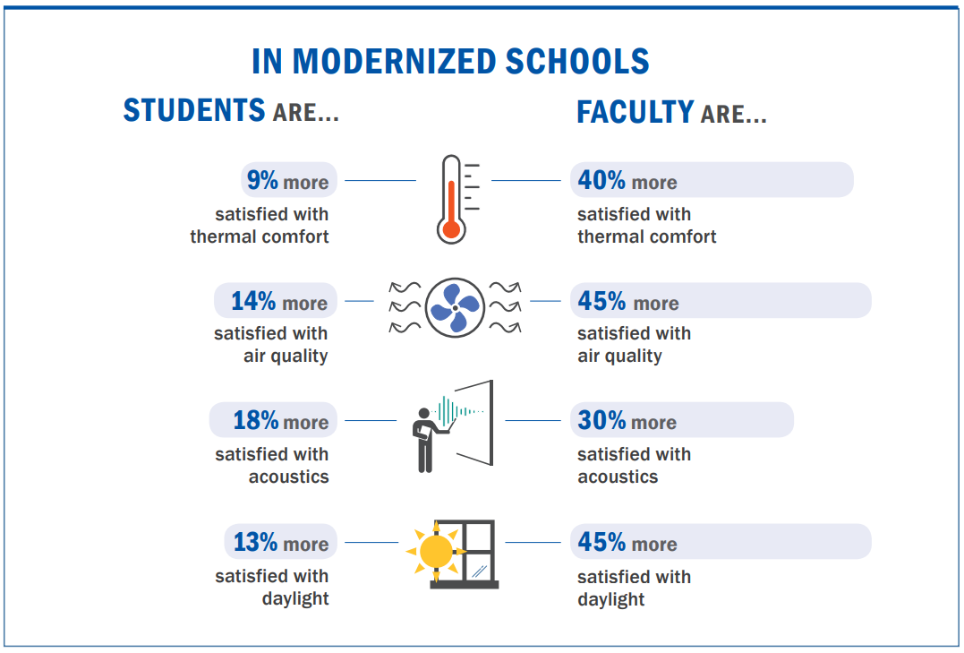
Value of Modernized Schools – Washington DC Study
Perkin Eastman – Investing in Our Future – Washington DC School Modernization Study

Slide 23
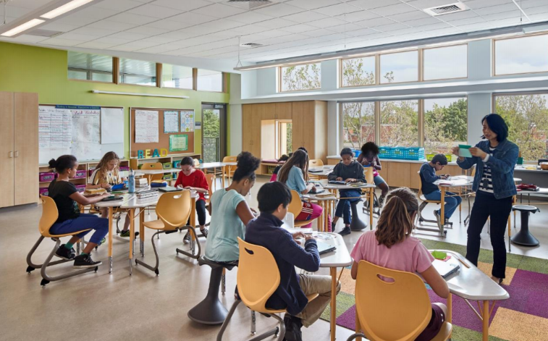
Modernized Washington DC School
Perkin Eastman – Investing in Our Future – Washington DC School Modernization Study

Slide 24
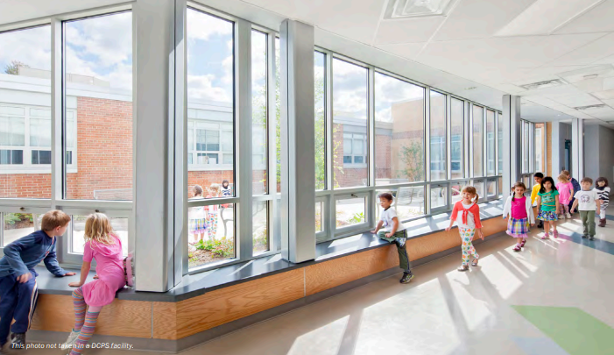
Modernized Washington DC School
Perkin Eastman – Investing in Our Future – Washington DC School Modernization Study

Slide 25
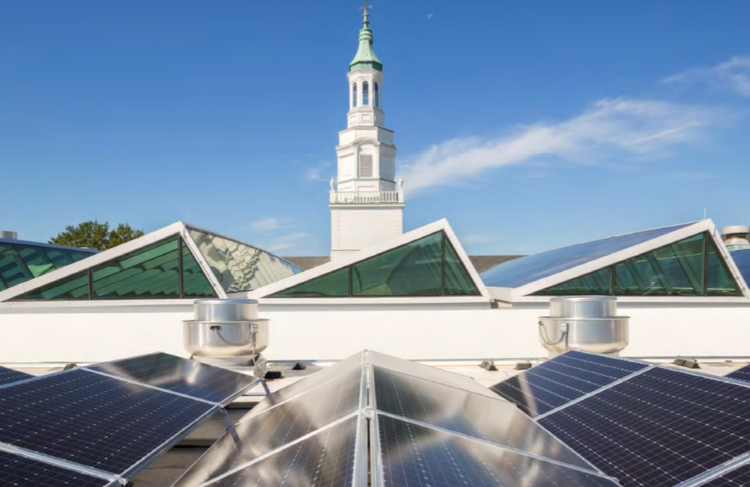
Modernized Washington DC Schools
Perkin Eastman – Investing in Our Future – Washington DC School Modernization Study

Slide 26
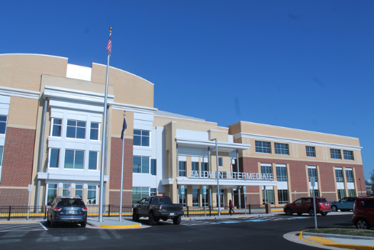
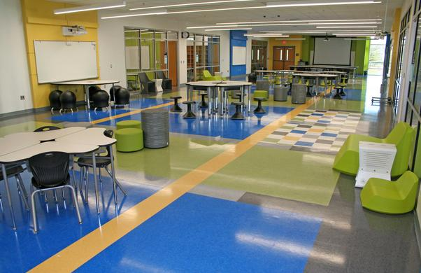
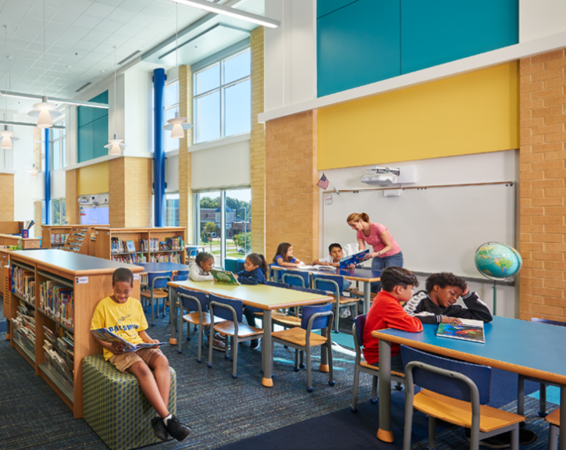
Baldwin Elementary and Intermediate School
Manassa, Virginia – Moseley Architects

Slide 27
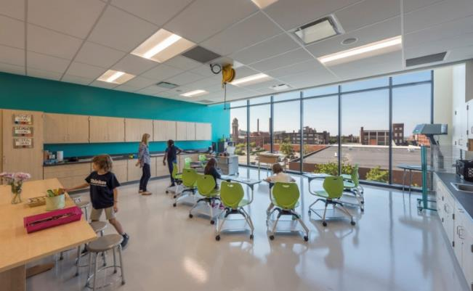
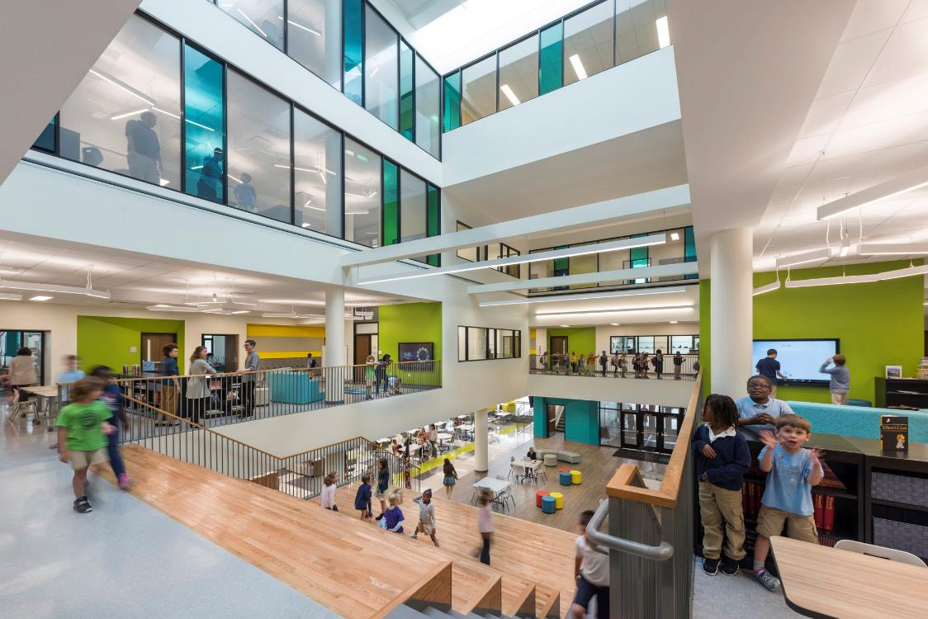
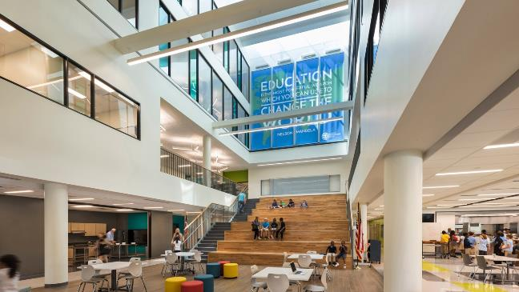
Campus International School (K-8)
Cleveland, OH – TDA Architects/Perkins+Will

Slide 28
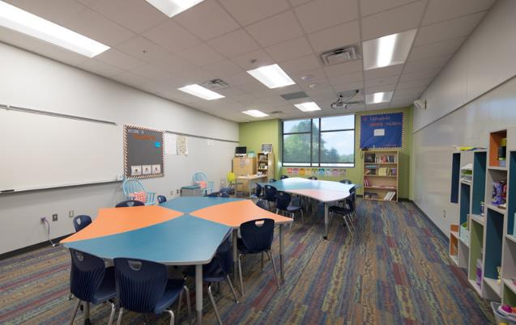
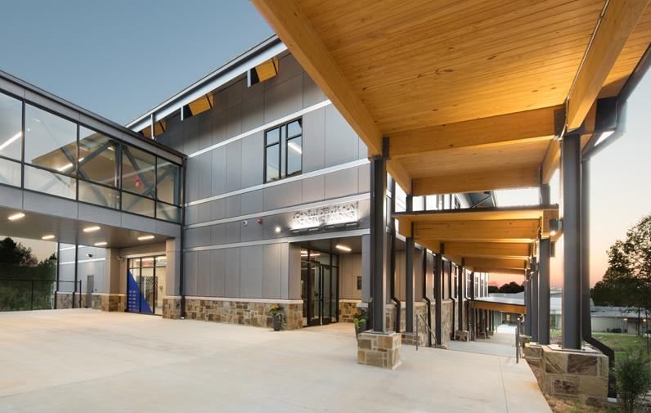
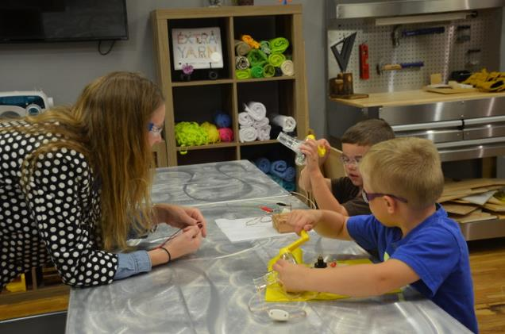
The New School
Fayetteville, AK– Hight Jackson Architects

Slide 29
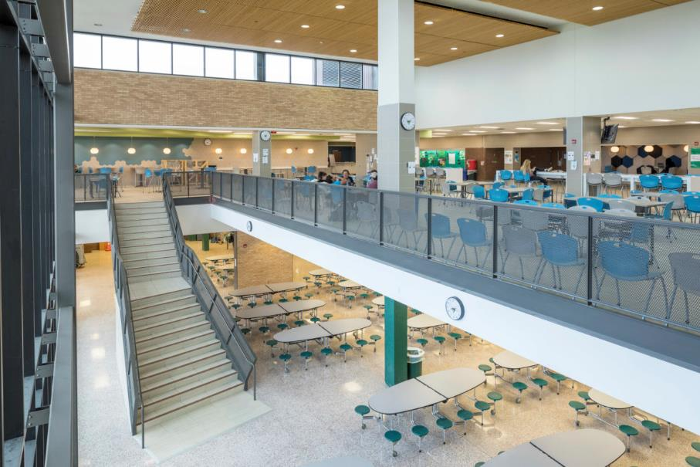
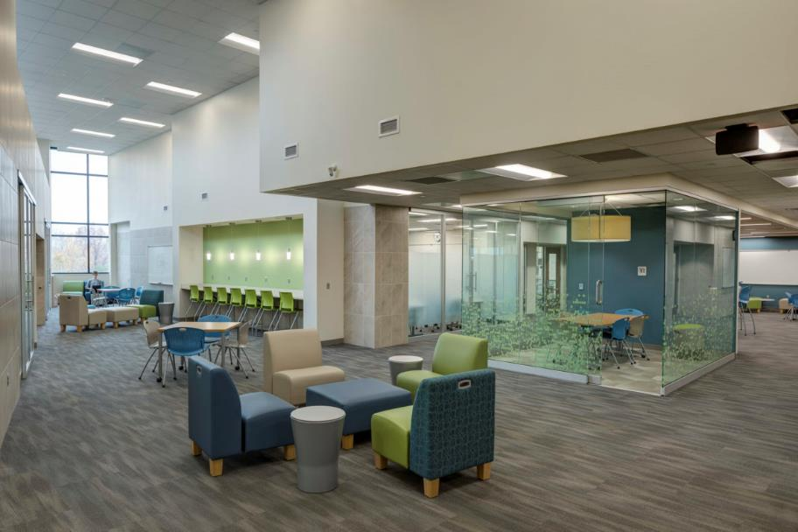
Edina High School
Edina, MN – Wold Architects and Engineers

Slide 30
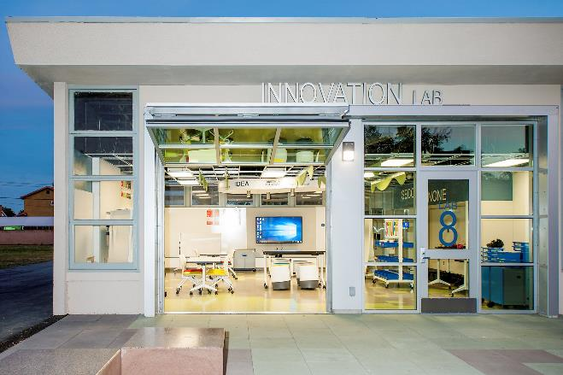
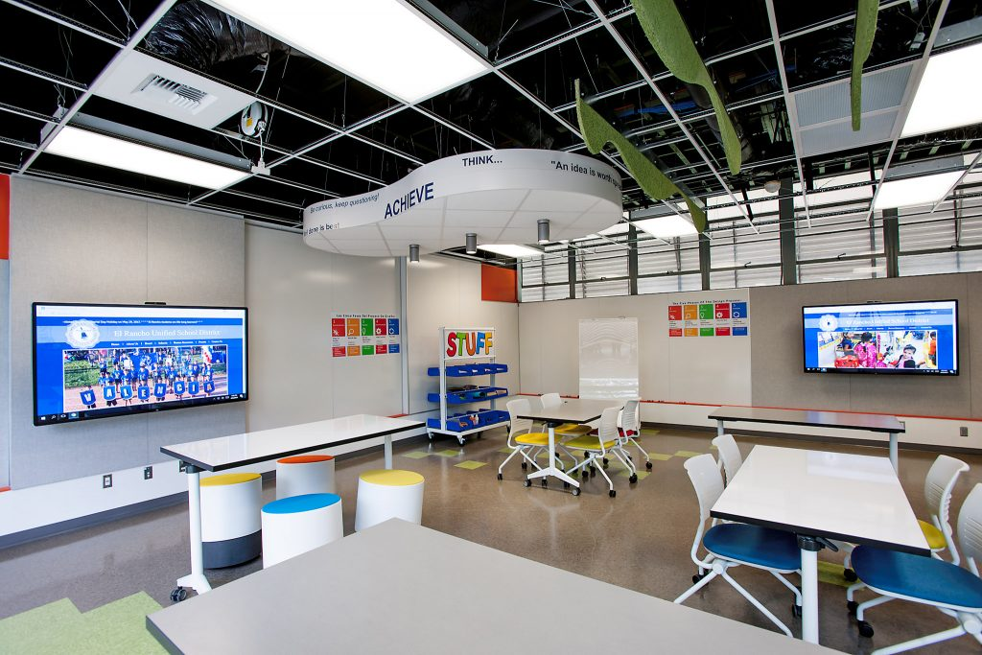
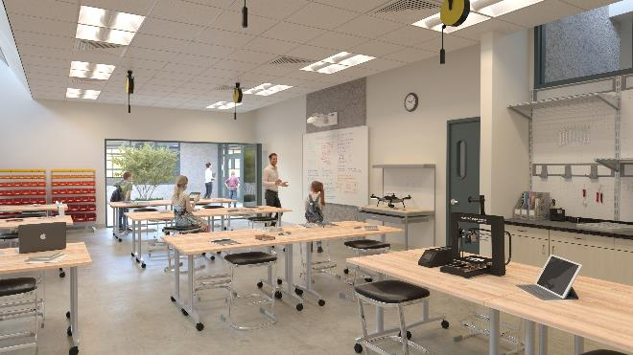
Rio Vista Elementary
Pico Rivera, CA – Joe LoBusso Architects

