Slide 1

Facilities Infrastructure
Condition Assessment
PRESENTED to the Board Of Education
December 19, 2018
Presented by:
Marios Demetriou, Assistant Superintendent-Operations
Emile Lauzzana, Executive Director – Physical Properties

Slide 2
Presentation Overview
K-12 School Infrastructure Quality
  National + State of Michigan
  Ann Arbor Public Schools
Facility Condition Assessment (FCA)
  FCA Overview
  FCA Review of AAPS Properties
  Facility Condition Index (FCI)
  FCA Capital Needs Findings
  Other Capital Needs
  Total Capital Needs vs. Available Funds
Capital Investment Scenarios
Overview of Possibilities

Slide 3
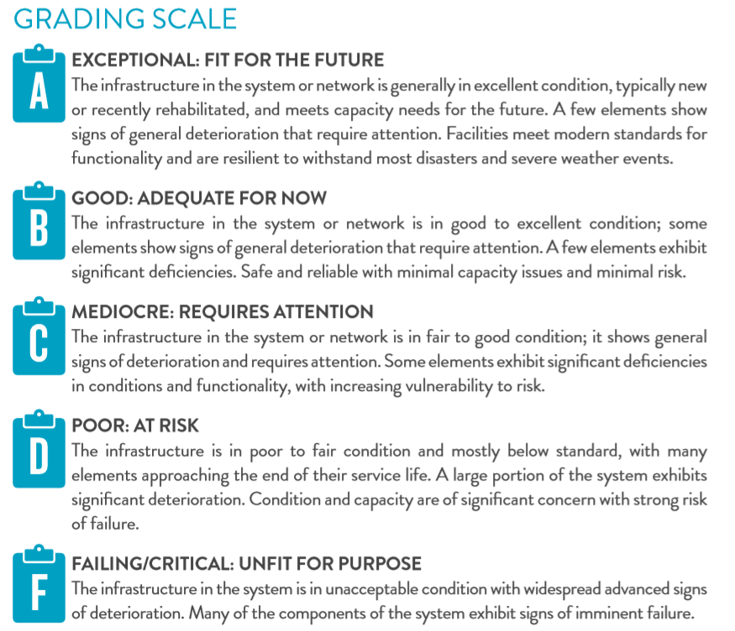

American Society of Civil Engineers - Infrastructure Report Card

Slide 4
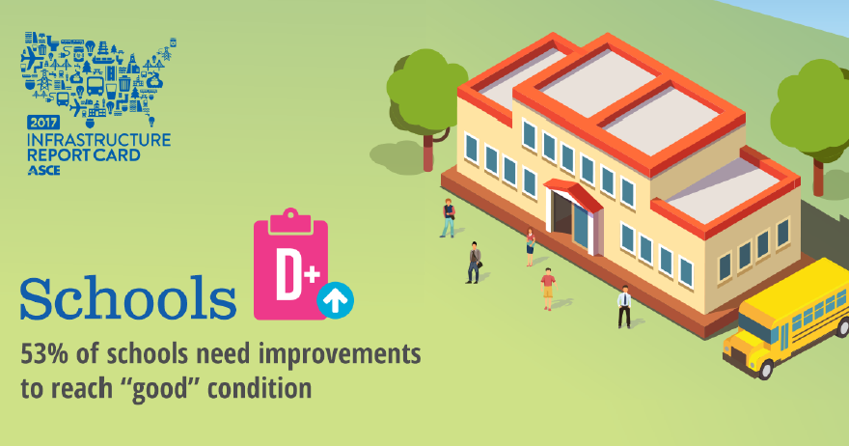
National K-12 Schools Infrastructure Grade = D+
Investment needed to improve and maintain school facilities:
        Annual need: $87 Billion
        Actual annual investment: $49 Billion
        Annual Investment Gap: $38 Billion
- American Society of Civil Engineers – 2017 Infrastructure Report

Slide 5

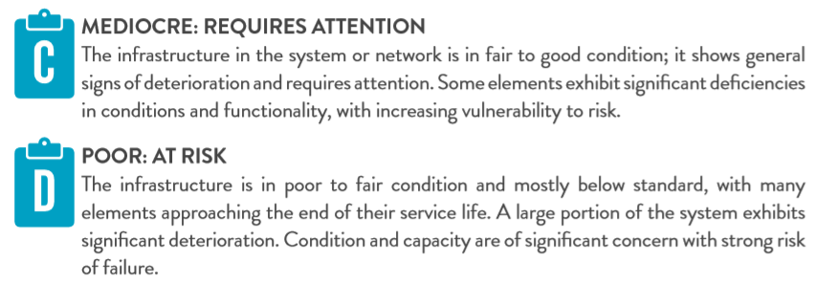

Michigan K-12 Schools Infrastructure Grade = D+
- American Society of Civil Engineers – 2017 Infrastructure Report

Slide 6
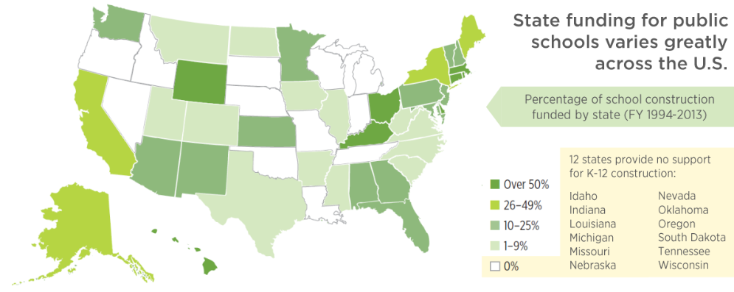
National K-12 Schools Infrastructure
Investment of State Governments
Michigan is one of only 12 states with
no state funding dedicated to school infrastructure
- U.S. Green Building Council - State of Our Schools Report 2016

Slide 7
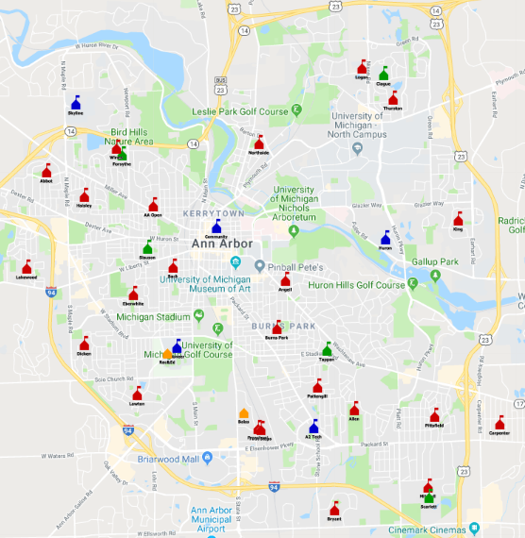
AAPS Facilities Overview
Number of Principal Buildings | 35
Total Square Footage | 3,476,090
Average Age of Buildings | 63 years
Total Acreage | 762
Number of Students | 18,434
Approximate Number of Staff | 2,400

Slide 8
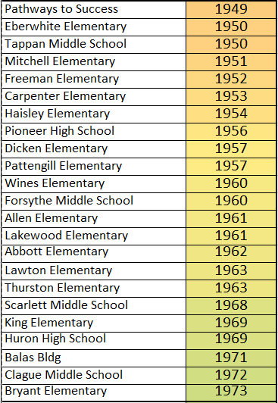
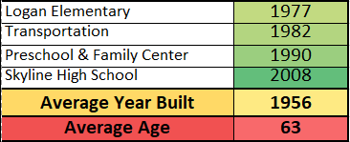
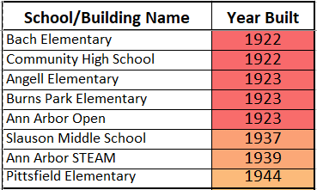
Average Age Of Facilities
The Baby Boomers
Generation X
The Original Build
The Greatest Generation

Slide 9
High Temperatures at Schools

Slide 10


Facility Condition Assessment (FCA)
AAPS commissioned a Facility Condition Assessment (FCA).
EMG Corporation was awarded a contract to conduct the FCA
FCA is life cycle engineering analysis of the condition of a facility in terms of age, design, construction methods, and materials.
The analysis is done by walk-through inspection and mathematical modeling. It includes calculations of useful life and conditions of building systems and equipment
The FCA identifies needed infrastructure investments and risks associated with continued deferral of maintenance and replacement investments

Slide 11
Facility Condition Assessment (FCA)
EMG is the largest technical assessment and project management company in the nation with over 700 million square feet of assessments in the last 5 years.
Their team of over 500 professionals offer clients a broad range of services including the life cycle engineering assessments, capital planning, and program and project management.
Clients include public school districts across the country, including: Hartford Public Schools (63 schools), Chicago Public Schools (283 schools), District of Columbia Public Schools (120 schools), and many others.

Slide 12
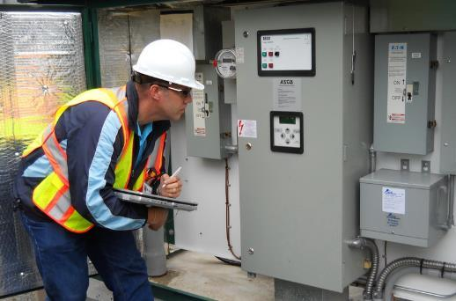
Facility Condition Assessment (FCA)
The FCA includes the following components:
Building Structure
  Foundations, Superstructure and Stairwells
Building Envelope
  Walls, Windows, Doors and Roof
Site Improvements
  Parking Lots, Walkways, Signage, Fencing, Athletic Fields, etc.
Building Interiors
  Doors and Finishes (Floors, Paint, Cabinets, Lockers, etc.)
Building MEPF Services (Mechanical, Electrical, Plumbing, and Fire Safety)
  Water Systems, Mechanical Systems, Electrical Systems, Elevators, Fire Safety Systems, Communications Systems, and Security Systems
Equipment and Furnishings
  Kitchen Equipment, Pool Equipment, Scoreboards, Theatre Systems, etc

Slide 13
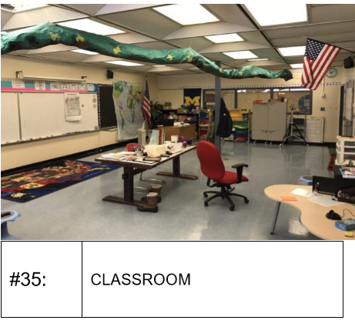
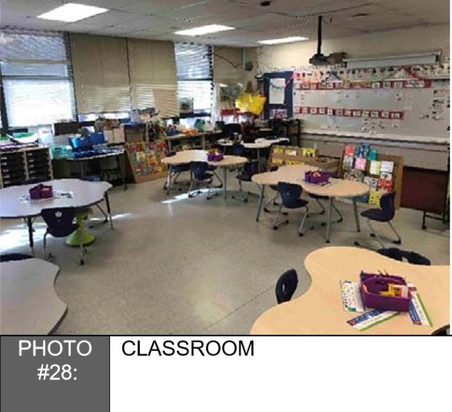
Outdated Classrooms

Slide 14
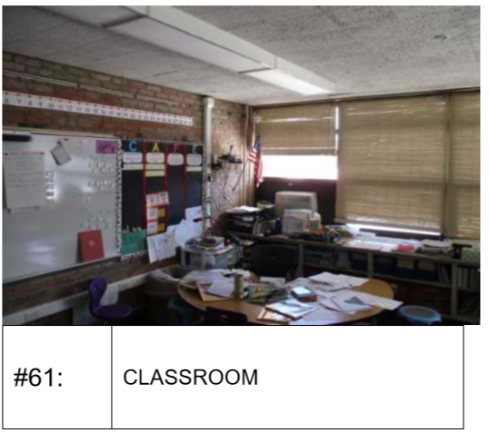
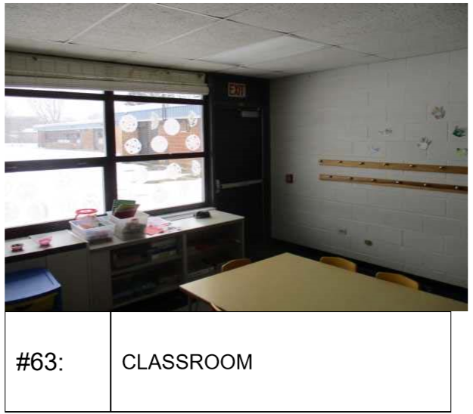
Outdated Classrooms

Slide 15
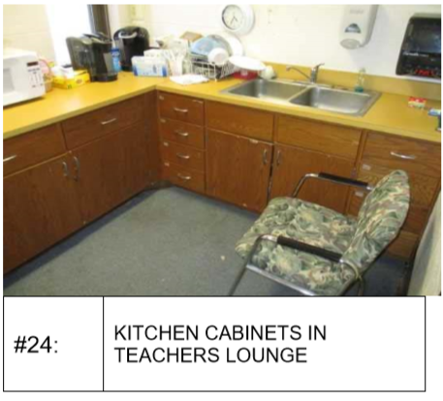
Teacher Lounges

Slide 16
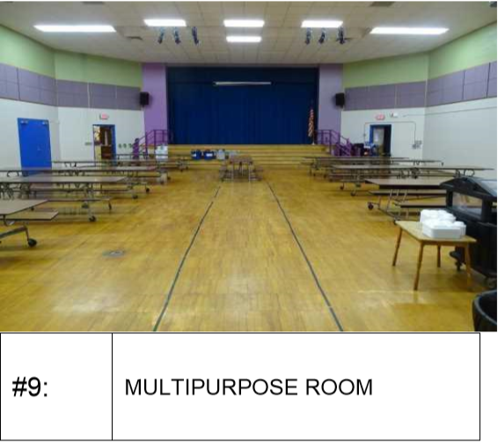
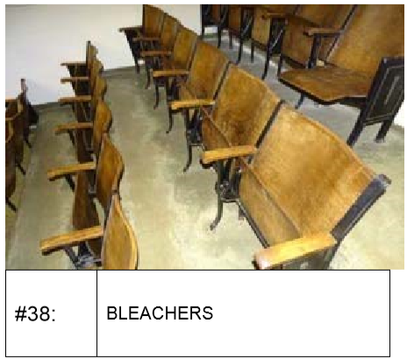
Theaters/Multi Purpose Rooms

Slide 17
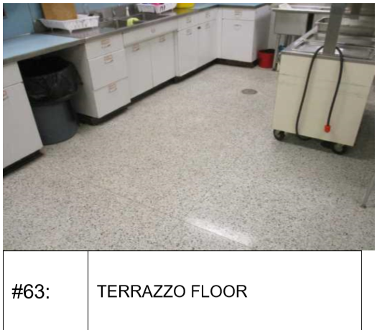
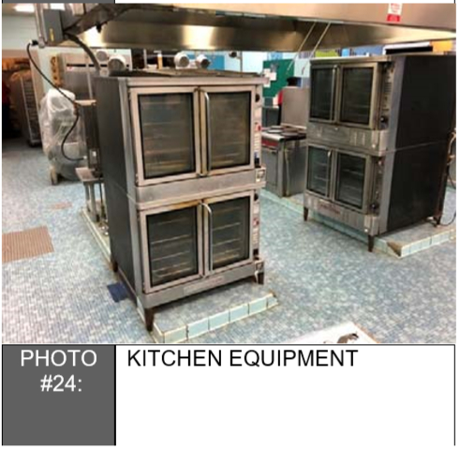
Kitchens

Slide 18
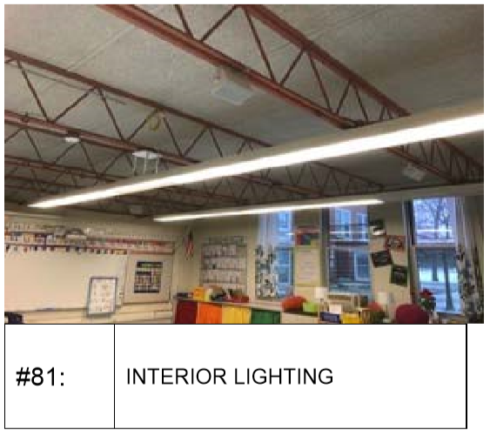
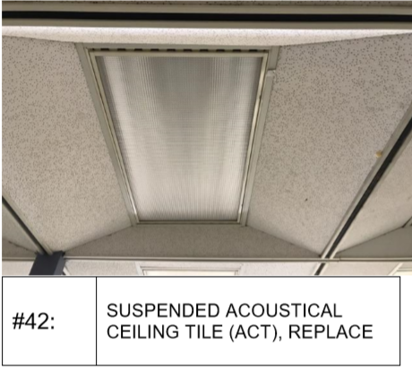
Lights and Ceilings

Slide 19
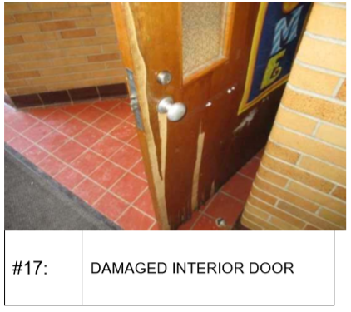
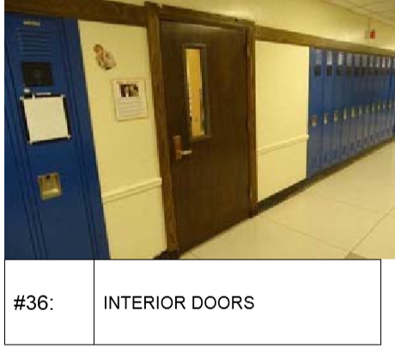
Interior Doors

Slide 20
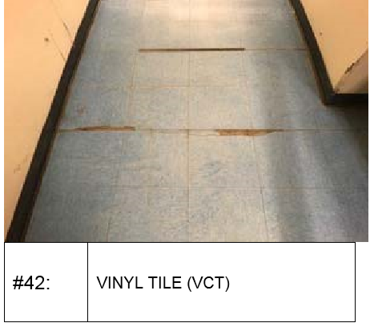
Flooring

Slide 21
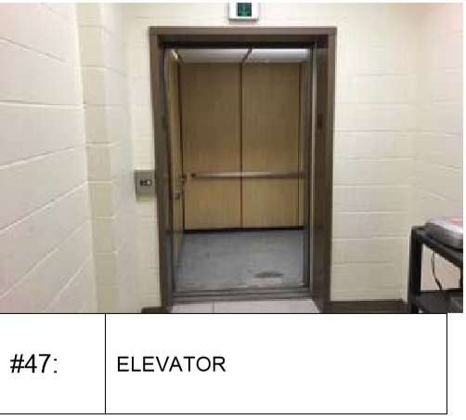
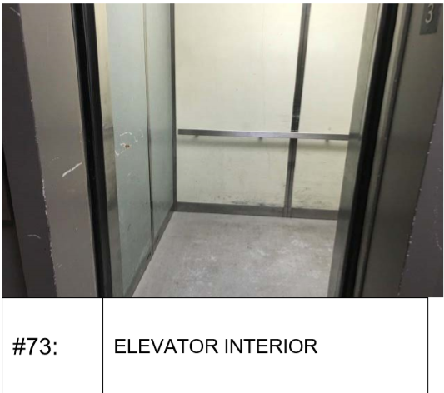
Elevators

Slide 22
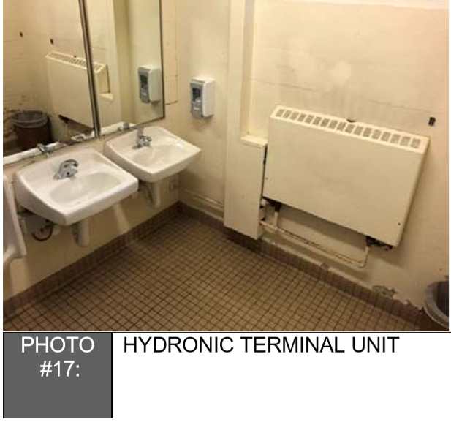
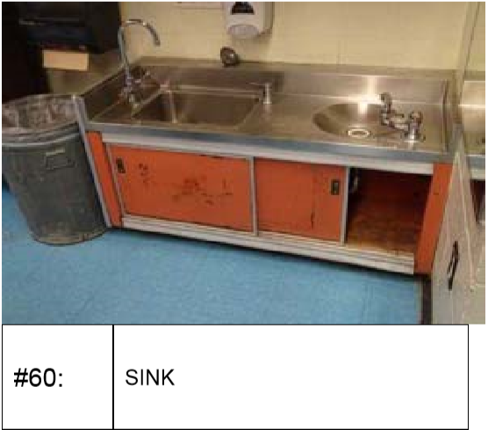
Plumbing Fixtures

Slide 23
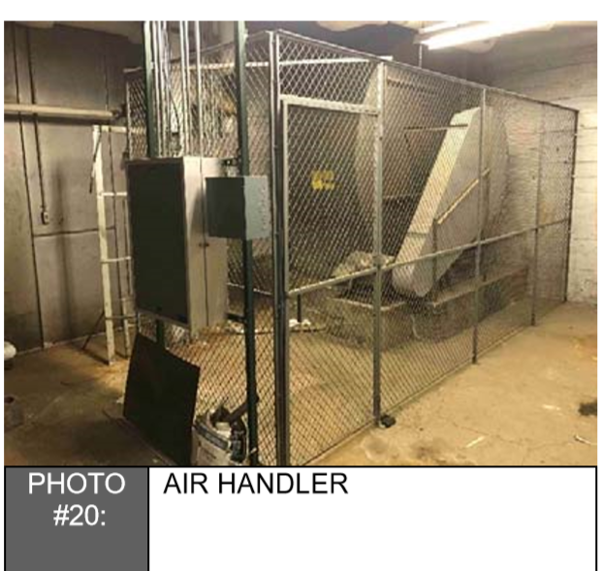
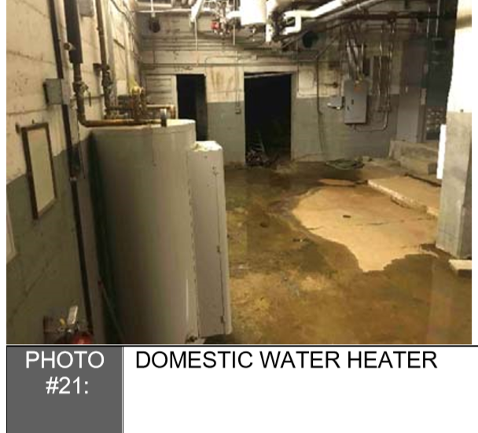
Mechanical Rooms

Slide 24
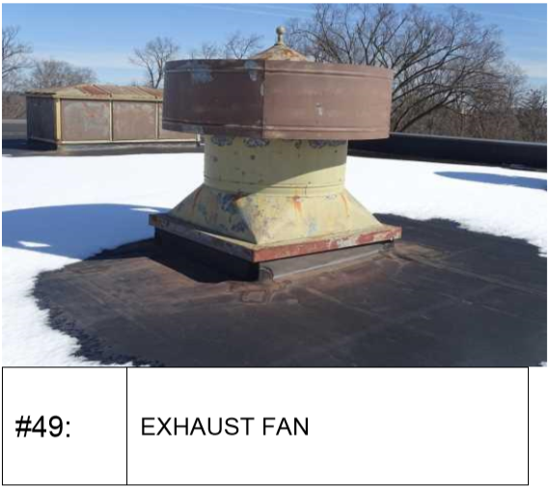
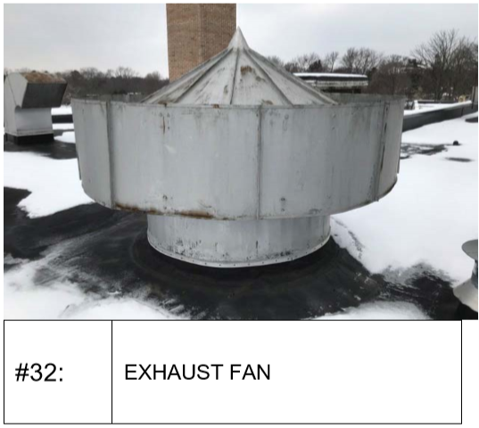
Exhaust Fans

Slide 25
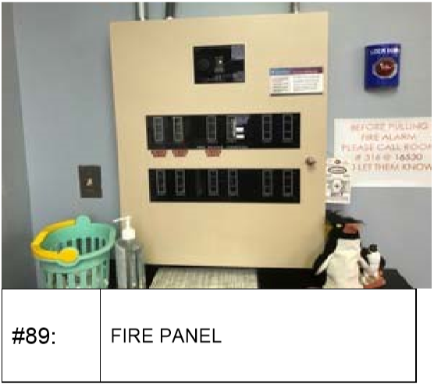
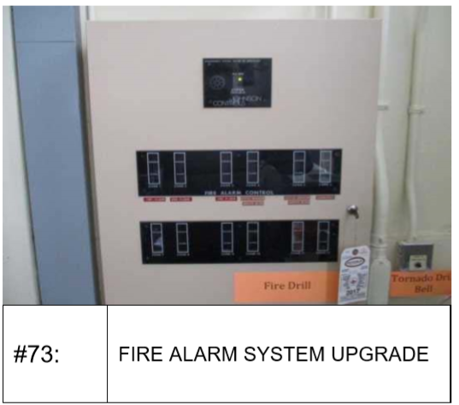
Fire Safety Systems

Slide 26
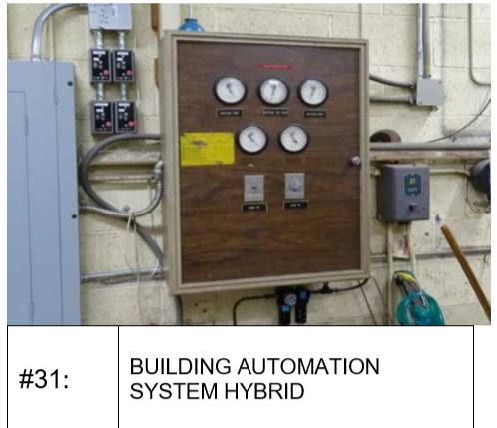
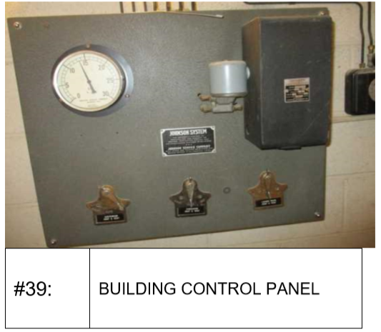
Building HVAC Controls

Slide 27
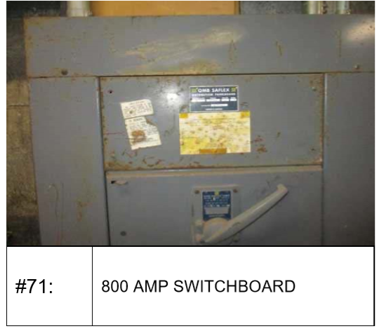
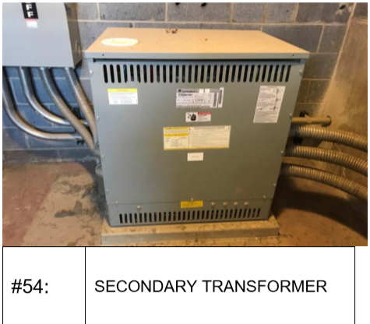
Electrical Systems

Slide 28
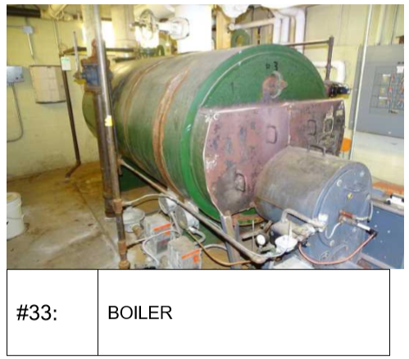
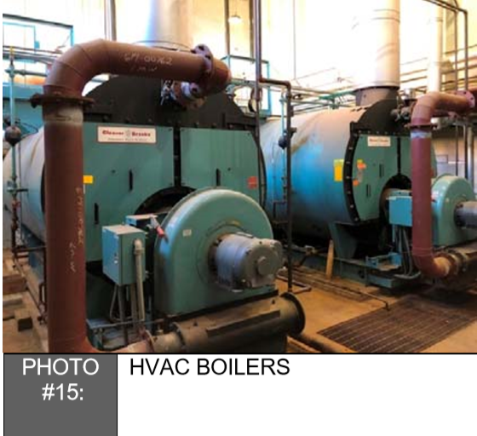
Boilers

Slide 29
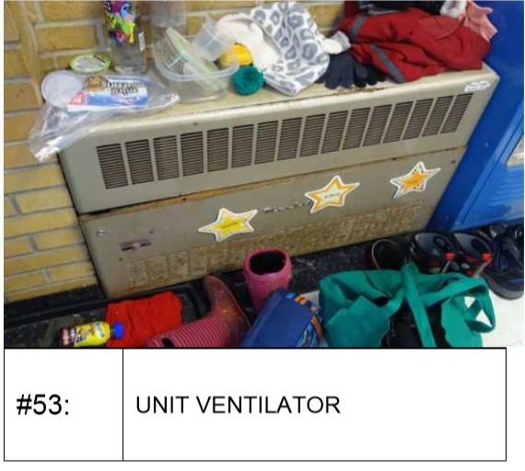
Heating Distribution Systems

Slide 30
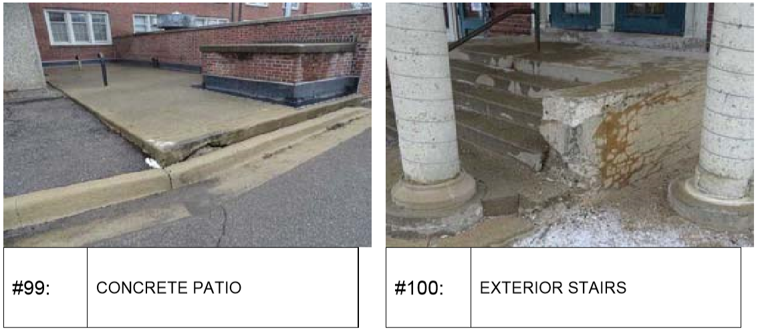
Exterior Concrete and Stairs

Slide 31
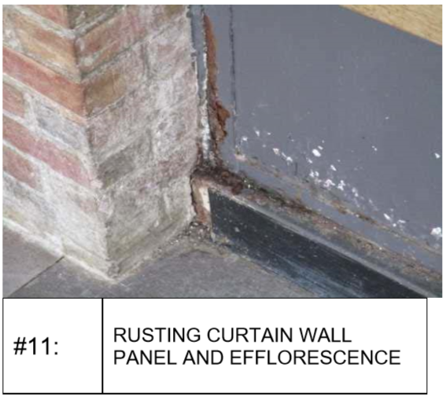
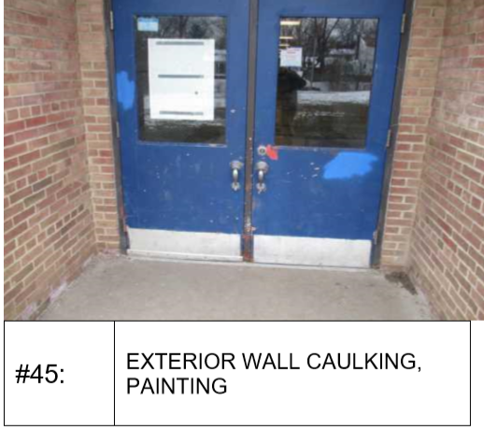
Exterior Doors and Windows

Slide 32
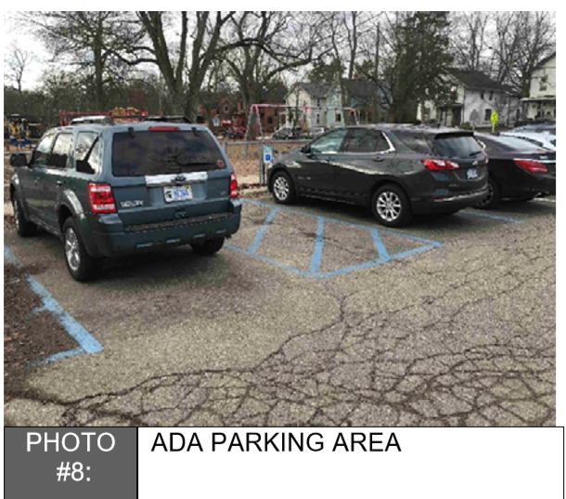
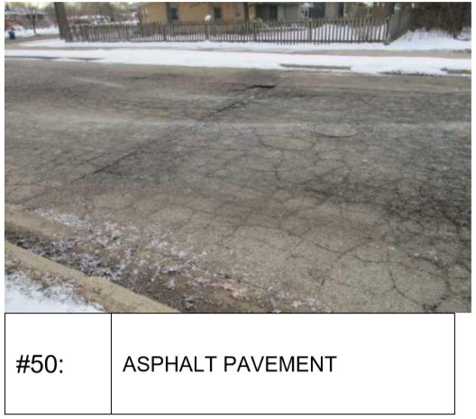
Parking Lots and Sidewalks

Slide 33
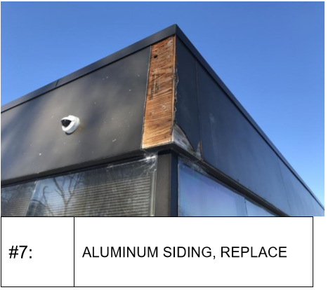
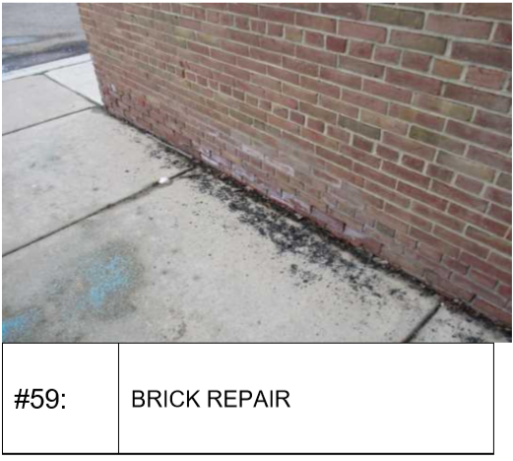
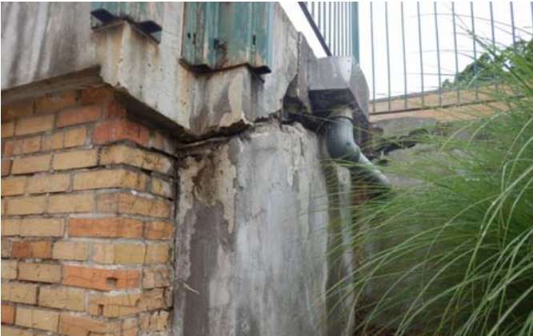
Building Facades

Slide 34
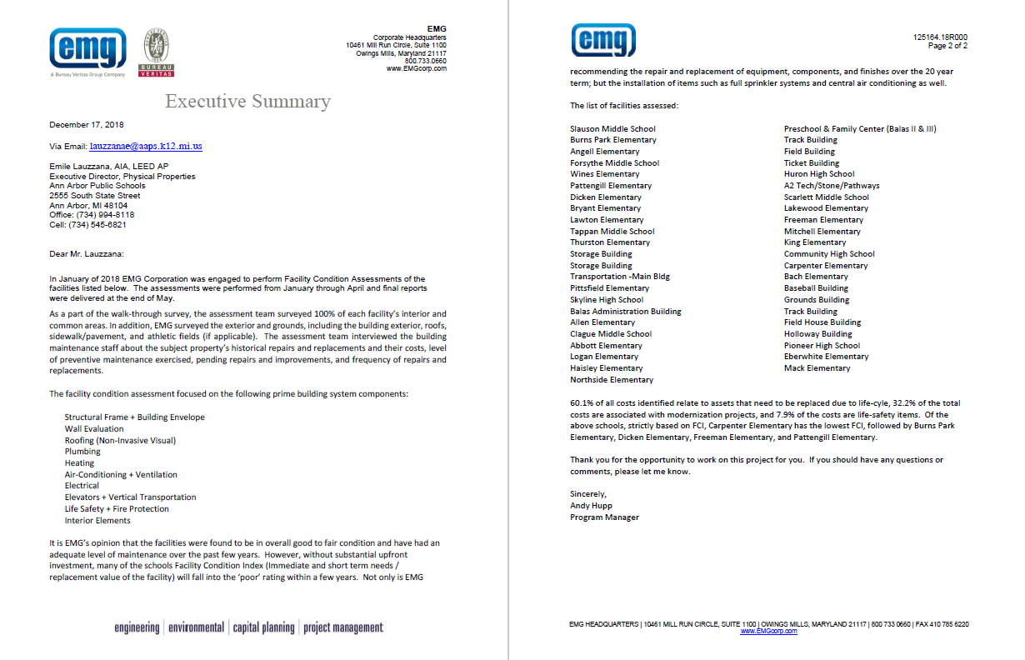
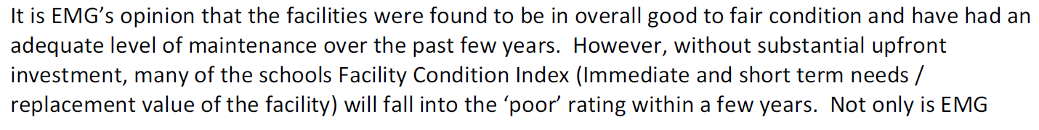
EMG Executive Summary

Slide 35
20-Year FCA Investment Needs
$ 823,779,962

Slide 37
$602M 20-Year FCA Capital Needs Gap
$282M 10-Year FCA Capital Needs Gap
$227M 5-Year FCA Capital Needs Gap
$103M 2-Year FCA Capital Needs Gap

Slide 38
5-Year FCA Investment Needs
$ 344,378,000

Slide 39



Typical FCA Results Table

Slide 40



Sample Schools - 5 Year FCA Needs
School | Square Feet | 5-Year FCA Needs | 5-Year FCA Needs / SF
Allen Elementary (1961) | 65,388 | $ 2,054,347 | $31 / SF
Community High School (1922) | 58,200 | $7,906,749 | $135 / SF
Carpenter Elementary (1953) | 52,539 | $11,463,982 | $218 / SF

Slide 41

Allen Elementary – 5 Year FCA Needs
5-Year FCA Investment Needs
$ 2,054,347 ($31/SF)
Major categorical needs identified in the FCA:
$750K - Heating, Ventilation, and Air Conditioning (HVAC)
$460K - Electrical, lighting, branch wiring and equipment
$400K Interior Improvements, walls, windows, doors and finishes
Other needs include:
Sitework – sidewalks and pavement
Resiliency improvements – onsite energy generation and infrastructure

Slide 42


Allen Elementary – FCA Needs Report

Slide 43

Allen Elementary – FCA Needs Report

Slide 44

Community High – 5 Year FCA Needs
5-Year FCA Investment Needs
$7,906,749 ($135/SF)
Major categorical needs identified in the FCA:
$2.9M - Heating, Ventilation, and Air Conditioning (HVAC)
$2.2M - Electrical, lighting, branch wiring and equipment
$1.65M – Fire Protection, infrastructure
Other needs include:
Interior improvements – ceilings, walls, floors and finishes
Exterior improvements – masonry updates, windows and doors

Slide 45


Community High – FCA Needs Report

Slide 46

Community High – FCA Needs Report

Slide 47




Community High – FCA Needs Report

Slide 48

Carpenter Elementary – 5 Year FCA Needs
5-Year FCA Investment Needs
$ 11,463,982 ($218/SF)
Major categorical needs identified in the FCA:
$2.65M - Heating, Ventilation, and Air Conditioning (HVAC)
$2.25M - Plumbing, distribution and fixtures
$1.8M - Electrical, lighting, branch wiring and equipment
$1.5M Exterior Improvements, walls, windows, doors and finishes
Other needs include:
Roofing – roof system and drainage
Interior improvements – ceilings, walls, floors and finishes
Fire protection – update infrastructure

Slide 49

Carpenter Elementary – FCA Needs Report

Slide 50

Carpenter Elementary – FCA Needs Report

Slide 51

Facility Condition Index (FCI)
The Facility Condition Index (FCI) is a standard facility management benchmark that is used to objectively assess the current and projected condition of a building asset. FCI is defined as:
the ratio of current year required renewal cost to current building replacement value.
0-5% 6%-10% 11%-30% 31%-50% 51%-100%

Slide 52


Slide 56
Facility Condition Assessment - Results
2-Year Investment Needs | $ 148,562,000
5-Year Investment Needs | $ 344,378,000
10-Year Investment Needs | $ 504,274,000
20-Year Investment Needs | $ 823,780,000

Slide 57
What does the FCA Include and Not Include?
Includes | Does Not Include
Existing Infrastructure Renewals and Replacements | New Classroom Additions for Student Growth
Schools Maintained in “Good/Fair” Condition | Schools Maintained in “Good/Exceptional” Condition
Air Conditioning added all schools | Furniture Refresh
Solar Power and Geothermal to reduce Carbon Footprint where feasible | Busing Fleet Refresh
Security Enhancements | Technology Refresh
Standard Classroom Environments (code minimum) | Optimized Healthy Classroom Environments
Union Wages | Constructing New/Replacement Schools

Slide 58
Cost of Items Not Included in the FCA
Additional Investment Needs (Not in FCA) | Annual Cost
New Schools and Classrooms for Student Population Growth | $ 10M/year
Furniture Refresh | $1M/year
Busing Fleet Refresh | $2M/year
Technology Refresh | $5M/year
Maintaining Schools in “Good/Exceptional” Condition | $5M/year
Annual TOTAL Additional Investment Needs | $23M/year
20-year TOTAL Additional Investment Needs (@3% inflation) | $ 618M

Slide 59
Total Capital Needs
 | FCA Needs | Other Needs (Not In FCA) | Total Needs
2-Years | $ 148,562,000 | $ 46,690,000 | $ 195,252,000
5-Years | $ 344,378,000 | $ 122,110,124 | $ 466,488,124
10-Years | $ 504,274,000 | $ 263,669,224 | $ 767,943,224
20-Years | $ 823,780,000 | $ 618,018,613 | $ 1,441,798,613

Slide 60
Capital Needs vs. Available Funds
 | Total Needs | Available Funds | Gap
2-Years | $ 195,252,000 | $ 45,157,553 | $ 150,094,447
5-Years | $ 466,488,124 | $ 117,320,542 | $ 349,167,582
10-Years | $ 767,943,224 | $ 222,241,923 | $ 545,701,301
20-Years | $ 1,441,798,613 | $ 222,241,923 | $ 1,219,556,690

Slide 62
Voted Bond Issues
Legislative Authority - 1351a of the Revised School Code
Voter Approval Required
Unlimited Tax General Obligations
    Voters authorize school district to issue a specific amount of bonds to pay for improvements identified in ballot proposition
    School district must levy whatever number of mills are necessary on the taxable property within the school district to make principal and interest payments on the bonds
    All of the work must be contracted
    None of the work can be paid to employees of the district

Slide 63
Capacity To Issue Additional Bonds
Debt Limitation - 15% of the total assessed valuation of the school district
      AAPS Taxable Value = $9.051B
      15% Of AAPS Taxable Value = $1.357B
      AAPS Outstanding Bonds = $0.160B
The additional bonding capacity = $1.197B

Slide 64
County-Wide Debt Millages
District | Total Debt Mills
Milan | 13.0000
Whitmore Lake | 8.3900
Dexter | 8.5000
Manchester | 8.5000
Saline | 8.0000
Lincoln | 7.3500
Chelsea | 7.0000
Ypsilanti | Two bonds 7.2200 & 13.0000
Ann Arbor | 2.4500

Slide 65
Voted Bond Issues – cont’d
Permissible Uses of Proceeds
  Constructing new school buildings and additions to existing school buildings
  Remodeling existing school buildings
  Energy conservation improvements
  Asbestos abatement
  Acquiring school buses (2015 Bond)

Slide 66
Voted Bond Issues – cont’d
Permissible Uses of Proceeds, cont’d
  Purchasing land
  Developing and improving sites, athletic and physical education facilities, and playgrounds (2015 Bond)
  Paying the costs related to the bond issue, such as professional fees, election fees, qualification fees, insurance fees, construction fund audit fees (2012 & 2015 Bonds)
  Purchasing loose furnishings and equipment (2015 Bond)

Slide 67
Voted Bond Issues – cont’d
Permissible Uses of Proceeds, cont’d
    Purchasing "technology", which is limited to: (2012 Bond)
        Hardware and communication devices that transmit, receive or compute information for pupil instructional purposes
        The initial purchase of operating system software and/or customized application software, accompanying the purchase of such hardware and communication devices
        The cost of the design and installation of the technology items listed above
    Refunding all or part of outstanding bond issues

Slide 68
Voted Bond Issues – cont’d
Maximum Bond Term – 30 years
    Further limited by the estimated useful life of the improvements
      Examples of estimated useful lives:
        School buses – 6 years
        Loose furnishings and equipment – 10 years
        Technology – 5 years

Slide 69
Voted Bond Issues – cont’d
Subject to the Construction Fund Audit Requirement
  Bond proceeds may be used only for the projects described in the ballot proposition
  For each series of bonds issued, a school district shall have an independent audit of its bonding activities conducted within 120 days after the date the last certificate of substantial completion is executed for all projects financed by bond proceeds

Slide 70
Voted Bond Issues – cont’d
Subject to the Construction Fund Audit Requirement, cont’d
  The school district shall submit the report to Treasury:
    Within 150 days after completion of all projects; or
    As part of the school district's annual audit for the next ended fiscal year
      Letter must be sent to Treasury, within 120 days after substantial completion, requesting this alternative
  Alternatively, the school district may engage an auditor to conduct the audit of bonded construction projects on an annual basis

Slide 71
Current Millage Payment Schedule
Levy Year | Fiscal Year End |  | Projected Tax Base |  | Growth Rate |  | Principal and Interest Payments |  | Mills Needed All Debt
2018 | 2019 |  | $ 9,051,605,246 |  | 5.19% |  | $ 22,176,433 |  | 2.45
2019 | 2020 |  | $ 9,458,927,482 |  | 4.50% |  | $ 22,712,749 |  | 2.40
2020 | 2021 |  | $ 9,695,400,669 |  | 2.50% |  | $ 21,684,280 |  | 2.24
2021 | 2022 |  | $ 9,937,785,686 |  | 2.50% |  | $ 21,660,729 |  | 2.18
2022 | 2023 |  | $ 10,186,230,328 |  | 2.50% |  | $ 20,163,949 |  | 1.98
2023 | 2024 |  | $ 10,440,886,086 |  | 2.50% |  | $ 20,160,672 |  | 1.93
2024 | 2025 |  | $ 10,701,908,238 |  | 2.50% |  | $ 20,085,441 |  | 1.88
2025 | 2026 |  | $ 10,969,455,944 |  | 2.50% |  | $ 14,892,398 |  | 1.36
2026 | 2027 |  | $ 11,243,692,343 |  | 2.50% |  | $ 13,293,228 |  | 1.18
2027 | 2028 |  | $ 11,524,784,651 |  | 2.50% |  | $ 13,194,624 |  | 1.14
2028 | 2029 |  | $ 11,812,904,268 |  | 2.50% |  | $ 13,157,967 |  | 1.11
2029 | 2030 |  | $ 12,108,226,874 |  | 2.50% |  | $ - |  | 0.00
 |  |  |  |  |  |  | $ 203,182,470

Slide 72
Ann Arbor Public Schools All Taxable Values
 | Parcels |  | Taxable Value |  | Avg. Taxable Value |  | Per Cent of Tax Base
Ann Arbor City | 35,905 |  | $ 5,790,833,612 |  | $ 161,282 |  | 64.00%
Ann Arbor Township | 2,050 |  | $ 534,327,422 |  | $ 260,648 |  | 5.91%
Lodi Township | 564 |  | $ 88,776,387 |  | $ 157,405 |  | 0.98%
Northfield Township | 142 |  | $ 19,287,034 |  | $ 135,824 |  | 0.21%
Pittsfield Township | 9,291 |  | $ 1,285,006,737 |  | $ 138,307 |  | 14.20%
Salem Township | 111 |  | $ 21,164,145 |  | $ 190,668 |  | 0.23%
Scio Township | 5,596 |  | $ 989,496,461 |  | $ 176,822 |  | 10.94%
Superior Township | 1,453 |  | $ 306,632,773 |  | $ 211,034 |  | 3.39%
Webster Township | 102 |  | $ 13,119,089 |  | $ 128,619 |  | 0.14%
TOTALS | 55,214 |  | $ 9,048,643,660 |  | $ 163,883 |  | 100.00%

Slide 73
Ann Arbor Public Schools Residential Values 2016-17
 | Parcels |  | Taxable Values |  | Avg. Taxable Value |  | Per Cent of Tax Base
Ann Arbor City | 27,887 |  | $ 3,341,671,323 |  | $ 119,829 |  | 45.14%
Ann Arbor Township | 1,658 |  | $ 313,342,104 |  | $ 188,988 |  | 4.23%
Lodi Township | 2,326 |  | $ 349,439,632 |  | $ 150,232 |  | 4.72%
Northfield Township | 3,974 |  | $ 261,572,654 |  | $ 65,821 |  | 3.53%
Pittsfield Township | 10,328 |  | $ 1,133,828,496 |  | $ 109,782 |  | 15.32%
Salem Township | 2,951 |  | $ 277,810,091 |  | $ 94,141 |  | 3.75%
Scio Township | 5,737 |  | $ 868,931,757 |  | $ 151,461 |  | 11.74%
Superior Township | 5,511 |  | $ 501,798,594 |  | $ 91,054 |  | 6.78%
Webster Township | 2,688 |  | $ 353,869,824 |  | $ 131,648 |  | 4.78%
TOTALS | 63,060 |  | $ 7,402,264,475 |  | $ 117,384 |  | 100.00%

Slide 74
Additional Cost Of Options from Current Debt Millage Per Year
 |  |  |  |  |  |  | All Properties |  | Residential
 | Taxable Value |  | Taxable Value |  | Taxable Value |  | Taxable Value |  | Taxable Value
 | $ 100,000 |  | $ 150,000 |  | $ 200,000 |  | $ 163,883 |  | $ 117,384
Option 1 $533M | $ - |  | $ - |  | $ - |  | $ - |  | $ -
Option 2 $750M | $ 75 |  | $ 113 |  | $ 150 |  | $ 123 |  | $ 88
Option 3 $1B | $ 170 |  | $ 255 |  | $ 340 |  | $ 279 |  | $ 200

Slide 75
SUMMARY OF PROPOSED BONDING
Option 1 - $533M
No Change In Current Millage Rate
Issuance Year Bond Amount Bond Term Estimated Total Interest Cost Estimated Interest Rate
Series 2019 $16,000,000 19.88 yrs. $ 5,570,231 3.50%
Series 2022 $61,500,000 20.00 yrs. $ 28,145,000 4.00%
Series 2025 $140,500,000 20.00 yrs. $ 79,013,025 4.25%
Series 2029 $315,000,000 21.00 yrs. $233,317,800 4.50%
Total $533,000,000 $346,046,056
First Year Millage Average Millage Maximum Total Mills all Debt Increase in Debt Levy
.06 1.88 2.45 0.00
The Pro is that the millage rate remains the same, no increase necessary
The Cons are not enough funds are generated at the beginning in order to build new schools or complete all major renovations. Funds are only sufficient to maintain a Fair FCI learning environment at our schools
Recommend May 2019 Election

Slide 76
SUMMARY OF PROPOSED BONDING
Option 2 - $750M
0.75 Additional Mill To Current Millage
Issuance Year Bond Amount Bond Term Estimated Total Interest Cost Estimated Interest Rate
Series 2019 $50,000,000 19.88 yrs. $ 13,339,686 3.50%
Series 2022 $105,000,000 20.00 yrs. $ 44,470,000 4.00%
Series 2025 $210,500,000 20.00 yrs. $124,670,350 4.25%
Series 2029 $385,000,000 21.00 yrs. $302,167,350 4.50%
Total $750,000,000 $484,656,386
First Year Millage Average Millage Maximum Total Mills all Debt Increase in Debt Levy
.75 2.59 3.20 0.75
The Pros are that enough funds are generated at the beginning to build new schools and to maintain Good FCI learning environment at our schools
The Con is that the millage rate needed is increased by .75 Mills from current millage
Recommend November 2019 Election due to time needed to campaign for an increase

Slide 77
SUMMARY OF PROPOSED BONDING
Option 3 - $1B
1.70 Additional Mill To Current Millage
Issuance Year Bond Amount Bond Term Estimated Total Interest Cost Estimated Interest Rate
Series 2019 $130,000,000 19.88 yrs. $ 40,358,364 3.50%
Series 2022 $145,000,000 20.00 yrs. $ 64,372,800 4.00%
Series 2025 $250,500,000 20.00 yrs. $146,845,150 4.25%
Series 2029 $475,000,000 21.00 yrs. $372,857,625 4.50%
Total $1,000,000,000 $624,433,939
First Year Millage Average Millage Maximum Total Mills all Debt Increase in Debt Levy
1.70 3.47 4.15 1.70
The Pros are that enough funds are generated at the beginning to rapidly renew our schools and to maintain Exceptional FCI learning environment at our schools which will be of the highest quality
The Con is that the millage needed is increased by 1.70 Mills from current millage
Recommend November 2019 Election due to time needed to campaign for an increase

Slide 78
Proposed Options for Bonding
Prospective Timeline:
    May 2019 election
    First series issued June 2019
Calculation Parameters:
    Taxable Value is expected to grow 4.50% for 2019-20 and 2.50% thereafter

Slide 79
Timeline for a May 7, 2019 Election
January 30, 2019 – AAPS BOE to Adopt Resolution placing ballot on May 2019 Election
February 12, 2019 by 4:00 PM – AAPS BOE To Certify Text of Ballot Proposal to County Clerk
By April 1, 2019 – Clerk Publishes Notice of Last Day of Registration in Newspaper of General Circulation in School District and at least two Public Places in each Election Precinct in School District
April 8, 2019 – Last Day Clerk receives Registrations
By April 30, 2019 – Clerk must Publish Notice of Election in Newspaper of General Circulation in the School District once and at least two Public Places in each Election Precinct in School District
May 4, 2019 – Last Day for Absentee Voters Application
May 7, 2019 – Conduct Election, Polls open 7:00 AM to 8:00 PM

Slide 80
Timeline for a May 7, 2019 Election, cont’d
By May 12, 2019 – County Board of Canvassers shall meet to Canvass Election Results
By May 21, 2019 – County Board of Canvassers shall complete its Canvass and Adopt a Resolution Canvassing the Election Results
Immediately after Form is Certified – Certificates of the Determination Results should be Filed to 1) AAPS BOE 2) County Treasurer 3) WISD 4) Counsel

Slide 81

What could we create?

Slide 82



Bloomfield Hills High School
Bloomfield Hills, MI – Stantec Architects

Slide 83



Dexter High School
Dexter, MI – Kingscott Architects

Slide 84



Discovery Elementary
Arlington, VA – VMDO Architects
*Net-Zero Energy*

Slide 85


Cherry Crest Elementary
Belleview, WA – NAC Architects
*Nature Focused Design*

Slide 86


Slide 87


Value of Modernized Schools – Washington DC Study
Perkin Eastman – Investing in Our Future – Washington DC School Modernization Study

Slide 88

Modernized Washington DC School
Perkin Eastman – Investing in Our Future – Washington DC School Modernization Study

Slide 89


Modernized Washington DC School
Perkin Eastman – Investing in Our Future – Washington DC School Modernization Study

Slide 90


Modernized Washington DC Schools
Perkin Eastman – Investing in Our Future – Washington DC School Modernization Study

Slide 91



Baldwin Elementary and Intermediate School
Manassa, Virginia – Moseley Architects

Slide 92



Campus International School (K-8)
Cleveland, OH – TDA Architects/Perkins+Will

Slide 93



The New School
Fayetteville, AK– Hight Jackson Architects

Slide 94



Edina High School
Edina, MN – Wold Architects and Engineers

Slide 95



Rio Vista Elementary
Pico Rivera, CA – Joe LoBusso Architects

Slide 96


